Slide 1
GCxGC Analysis of DOM at SeaSCAPE
Emily Barnes
barnes_emily@berkeley.edu
Goldstein Group, UC Berkeley

Slide 2
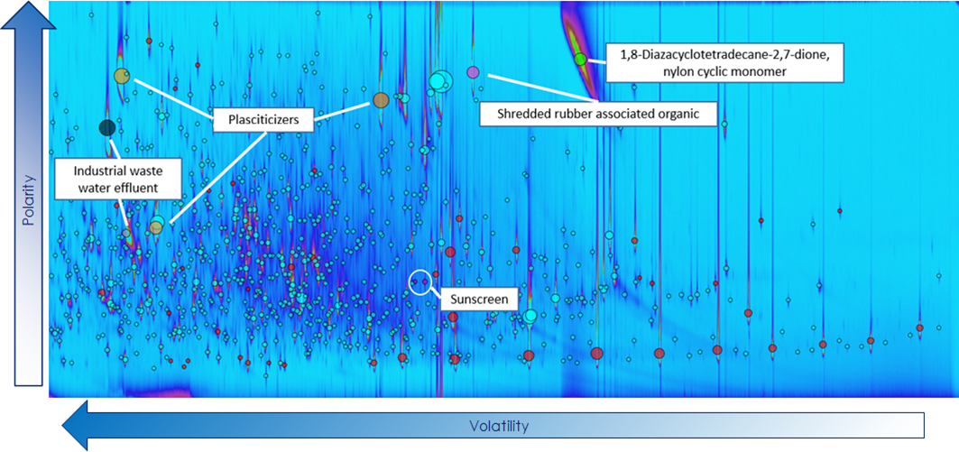
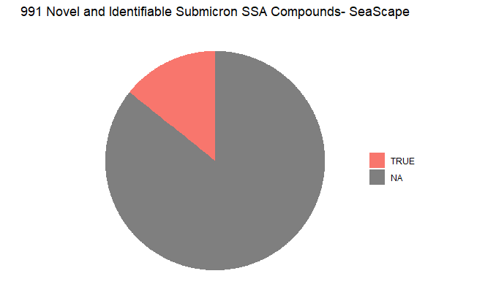
Instrument Range and Complexity
MDOM Compounds at SeaSCAPE
15% identifiable
85% unpublished
C13-C36 n-Alkane volatility equivalent range
~950 compounds separated and traced
15% of these are identifiable by mass spectral matching
Emily Barnes
barnes_emily@berkeley.edu

Slide 3
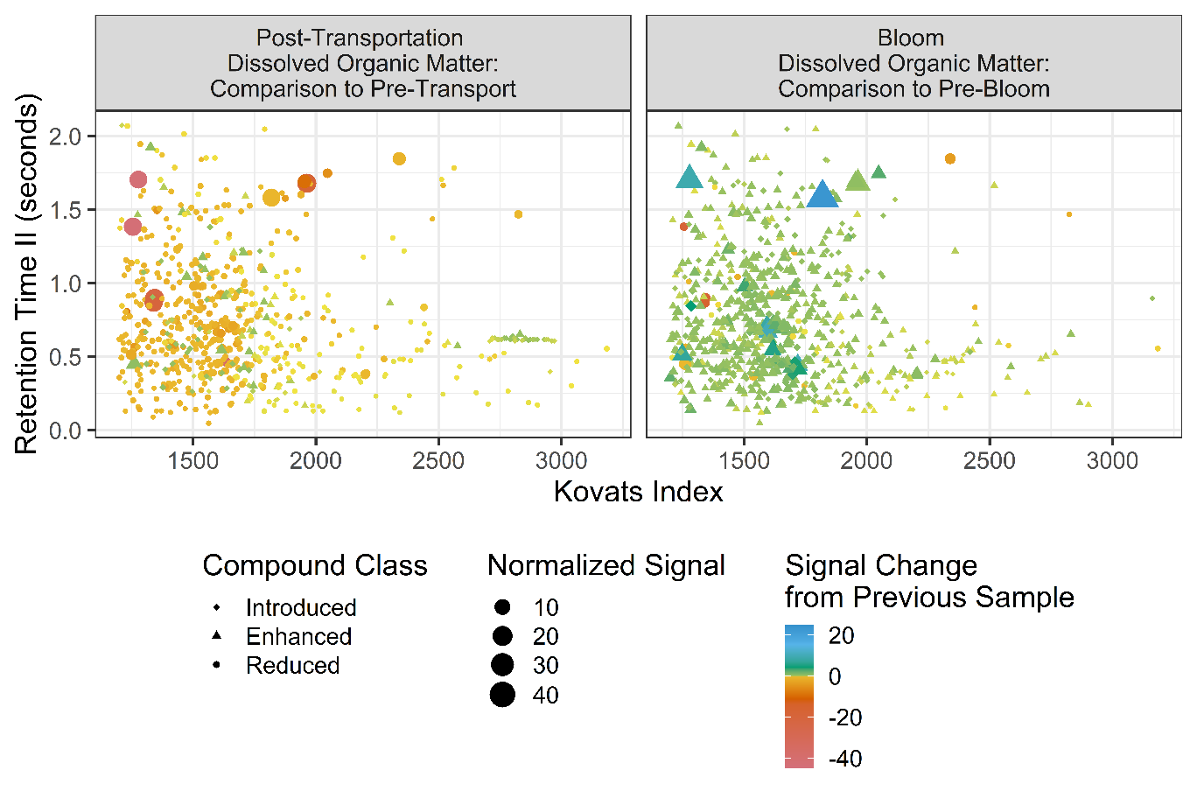
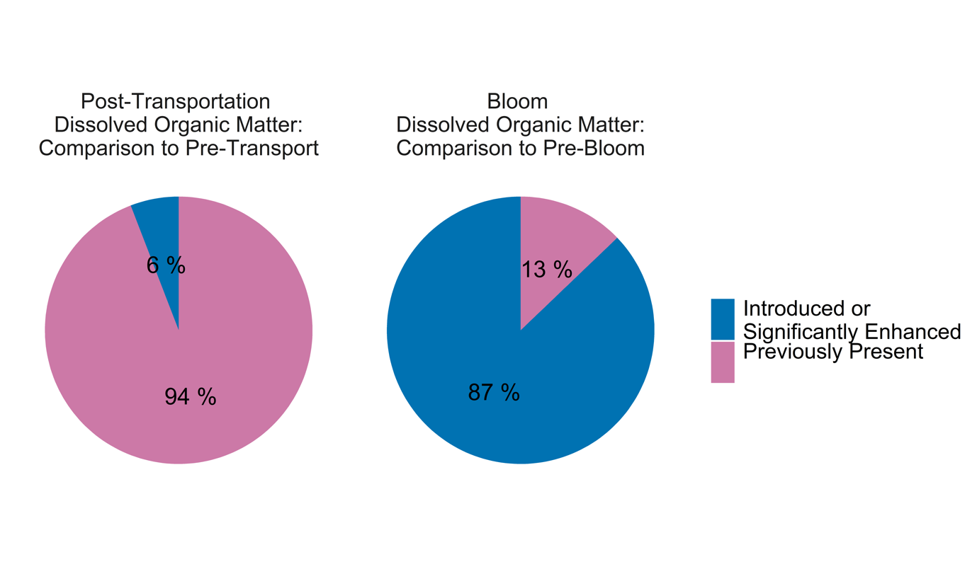
Transfer Cleanliness Analysis
Emily Barnes
barnes_emily@berkeley.edu

Slide 4
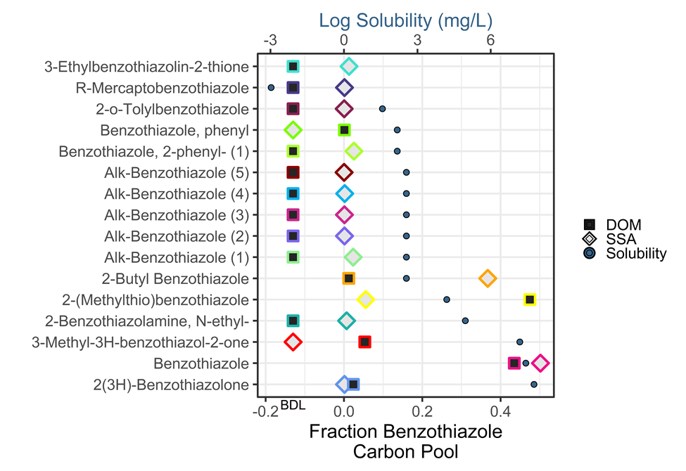
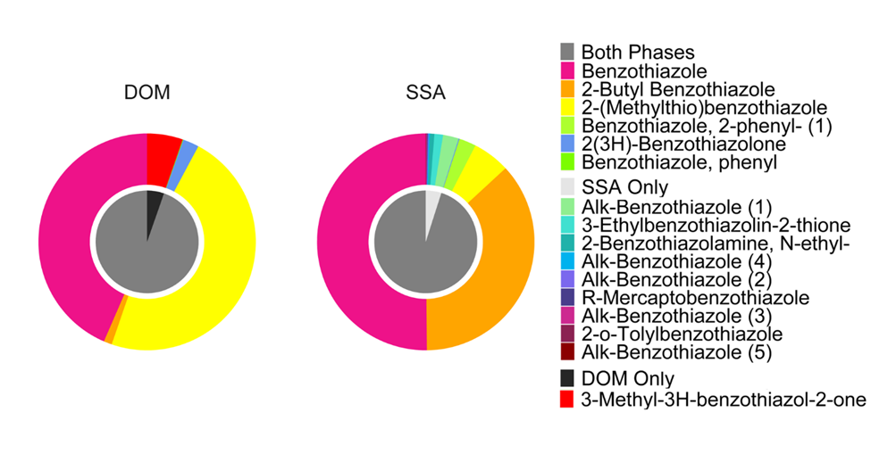
Compositional Comparison Analysis: Benzothiazoles
Emily Barnes
barnes_emily@berkeley.edu

